Slide 1


Virginia Premier
Master of Decision Analytics- Professional Track
May 7, 2019
VCU Team: Ryan Hawkins, Kyle Jacobs, Mallika Rodriguez, Yasin Seddiq
Virginia Premier Representative: Kyle Hawk

Slide 2
Executive Summary
Objective: Reduce Emergency Department (ED) usage by Virginia Premier (VP) members through Care Coordination
Strategy: Identify VP members with chronic conditions likely to use the ED in an upcoming visit
Results: Developed deployable model that identifies likelihood of members to use an ED in an upcoming visit
Notes:
Premise: Care coordination can help reduce preventable ED visits
Assumptions: Members will seek non-ED medical care services if encouraged by care coordinators
Approach: Prioritize certain members for care coordination outreach

Slide 3

Objective
Prioritize Virginia Premier (VP) members for Care Coordination.
Premise: Care coordination reduces Emergency Department (ED) visits
Assumption: No resource constraints
Guidance from VP: Look into chronic conditions and comorbidities
Challenges: HIPAA constraints, memory constraints, processing costs
Notes:
Image source: https://www.indeed.com/salaries/Care-Coordinator-Salaries-at-Virginia-Premier
Premise: Care coordination can help reduce preventable ED visits
Assumptions: Members will seek non-ED medical care services if encouraged by care coordinators
Approach: Prioritize certain members for care coordination outreach

Slide 4
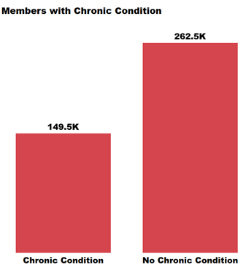
Members with Chronic Conditions

Slide 5
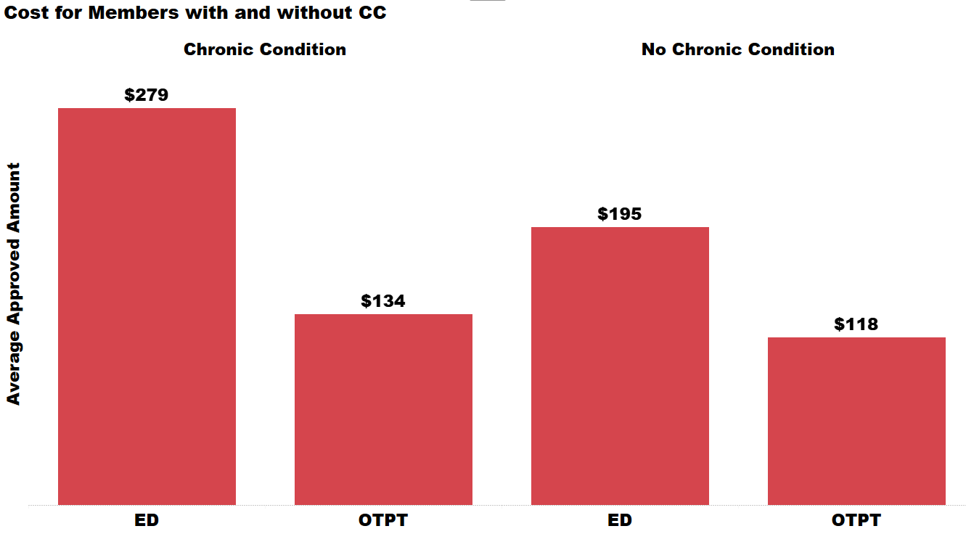
Member Costs

Slide 6
Creating the Dataset
clean_claims(data)
get_chronic_condition(data, splits)
get_upcoming_visits(data)
impute_ccs(data, splits)

Slide 7
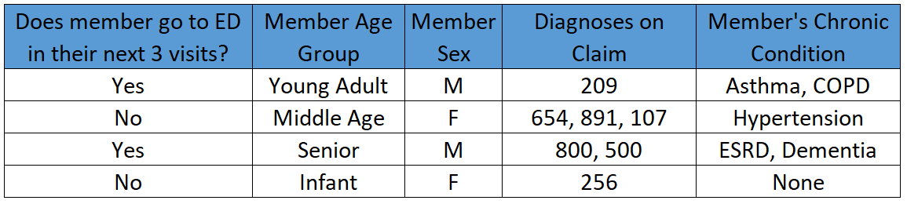
Model Dataset

Slide 8
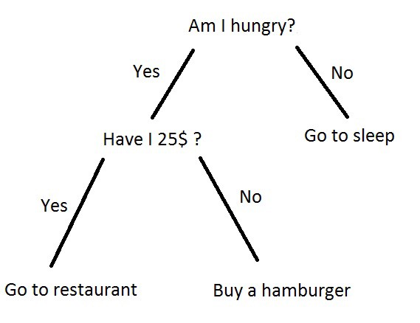

Slide 9
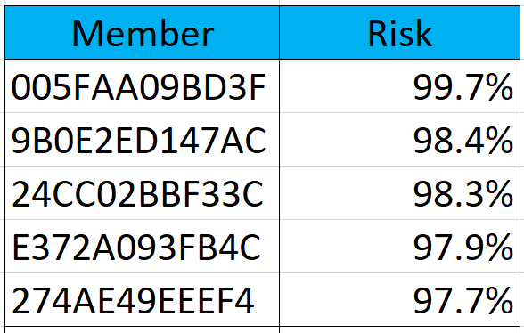
Model Output

Slide 10
Next Steps
Develop strategy for deploying model internally
Optimize model by adding in other proprietary information (i.e., HIPAA, location, precise date/time)
Train Care Coordinators on how to implement prioritization framework
Run model on a regular cadence to re-train data
Continue exploring emerging research related to preventable ED usage

Slide 11
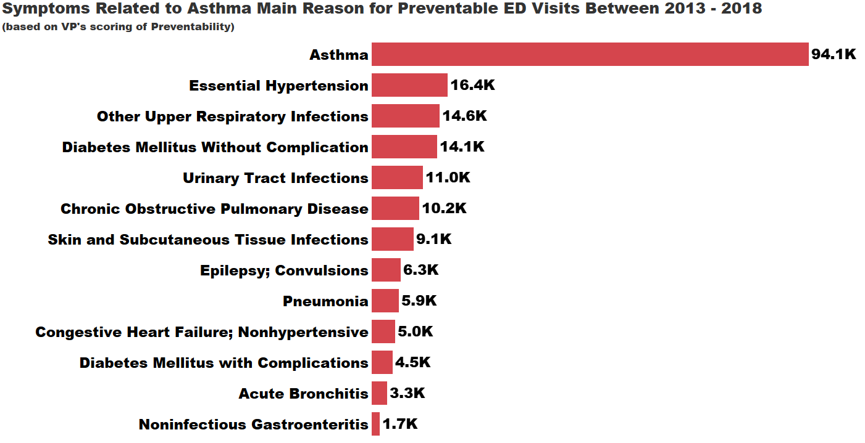

Slide 12
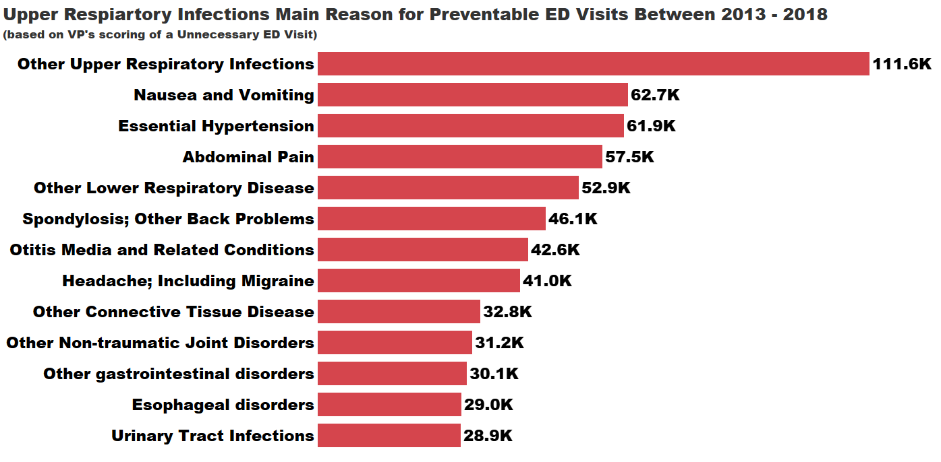

Slide 13
Questions?

